Slide 1
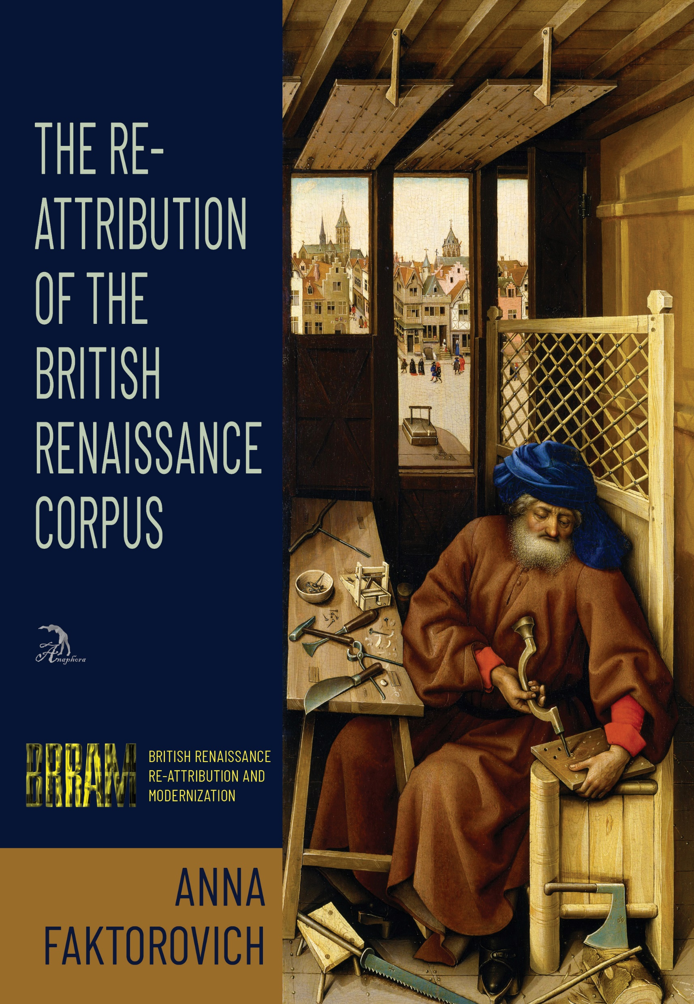
Re-Attribution of the British Renaissance
By: Anna Faktorovich, PhD
https://anaphoraliterary.com/attribution

Slide 2
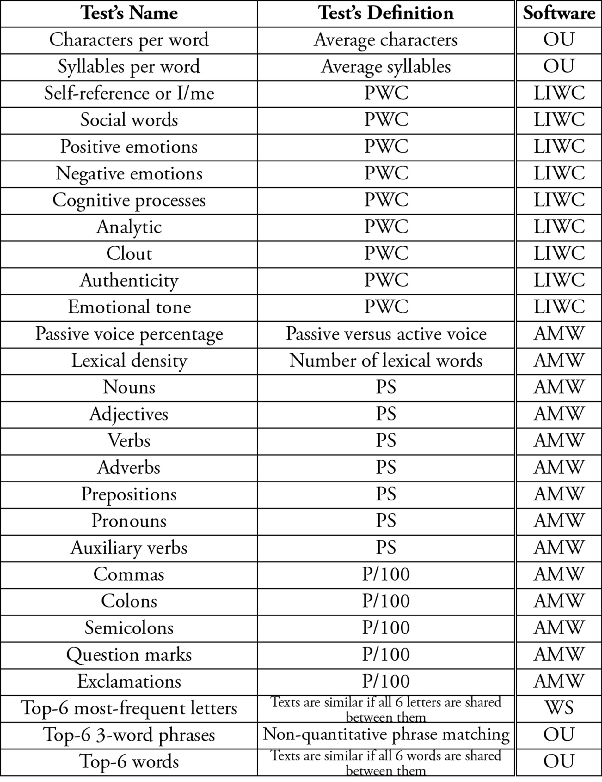
Computational Linguistic Tests

Slide 3
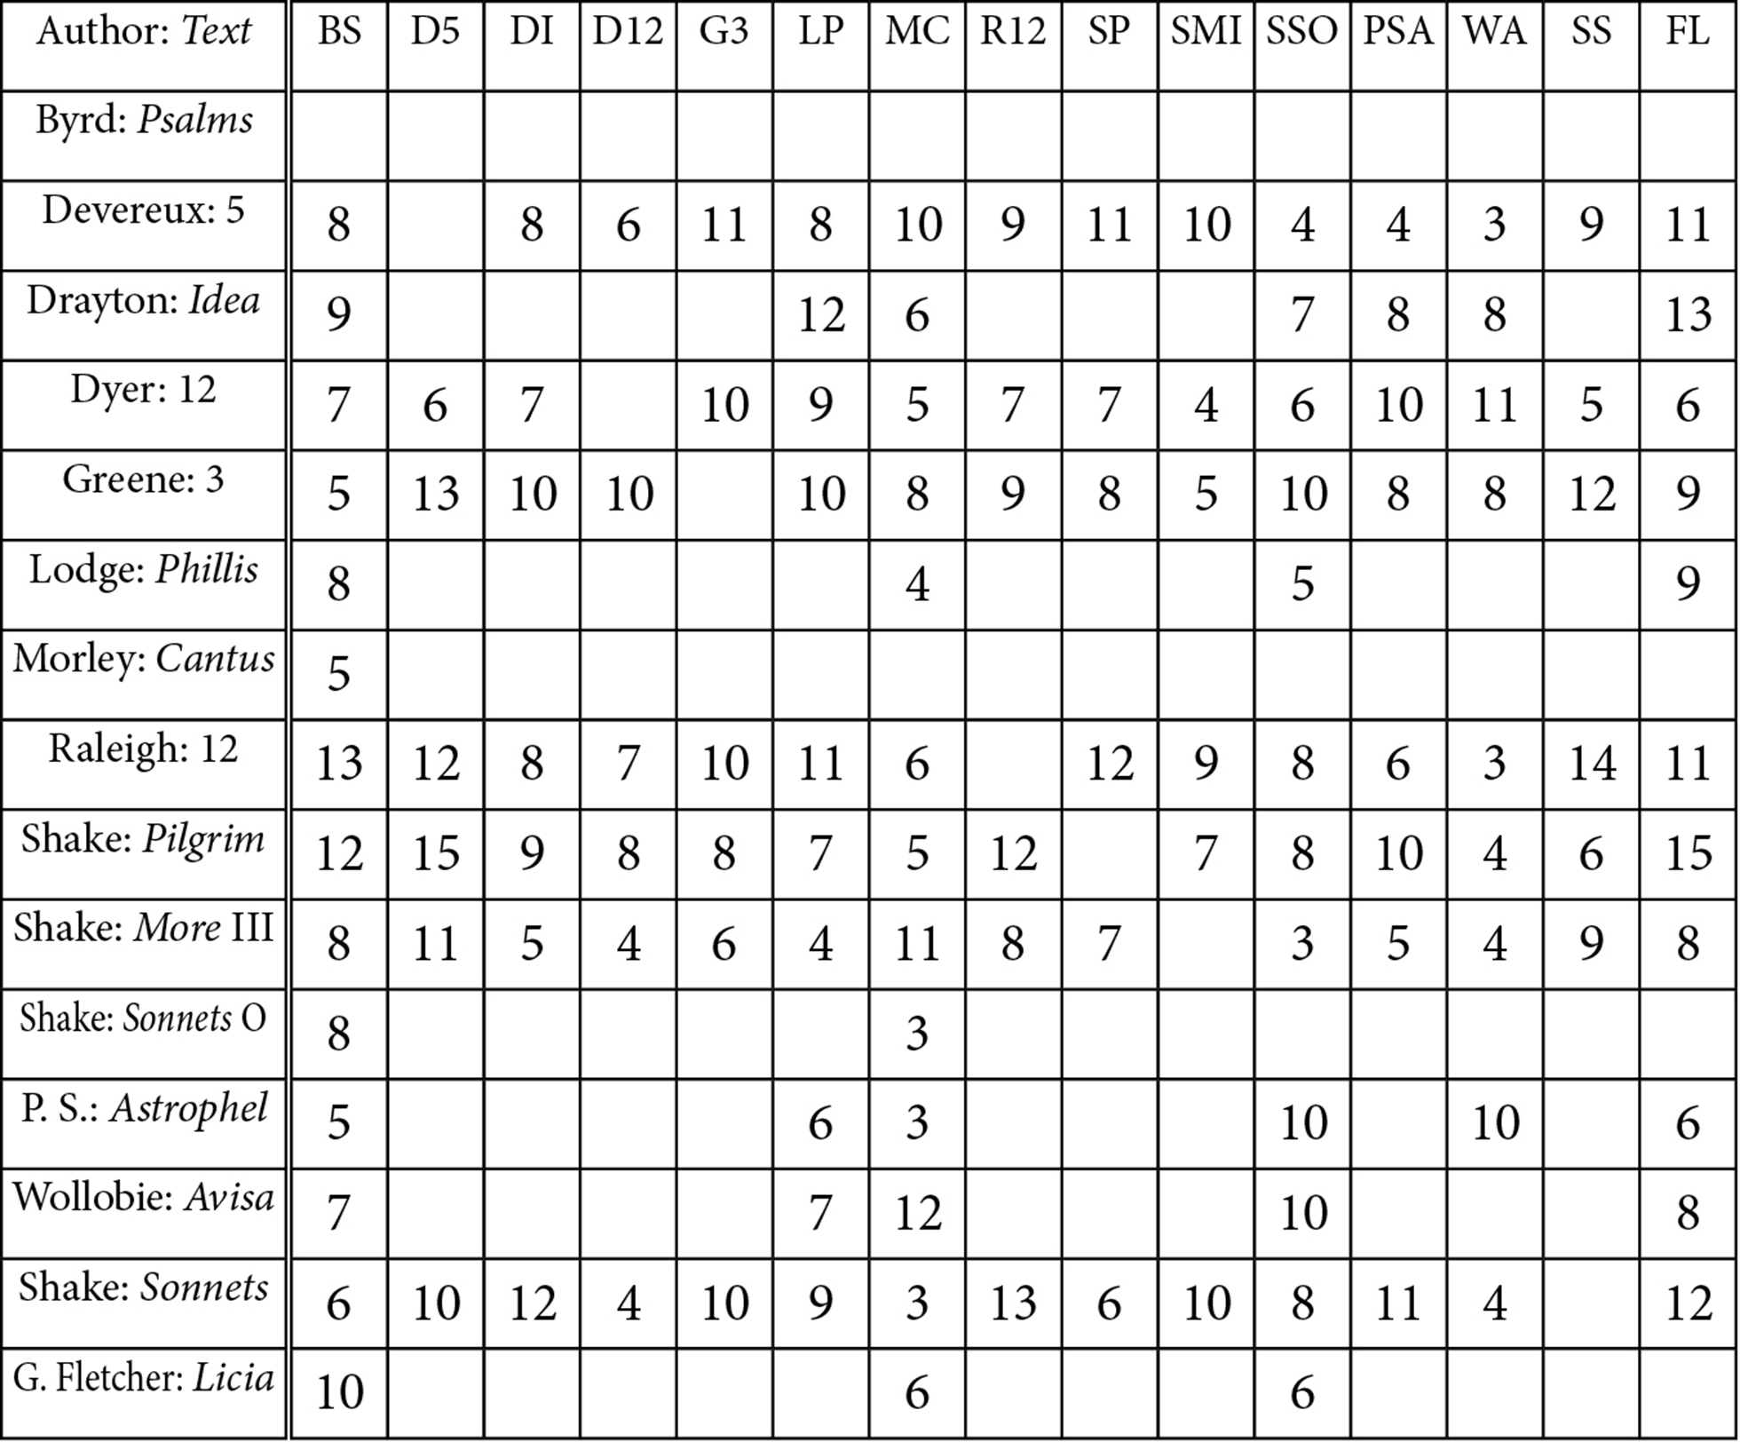
BYrd

Slide 4
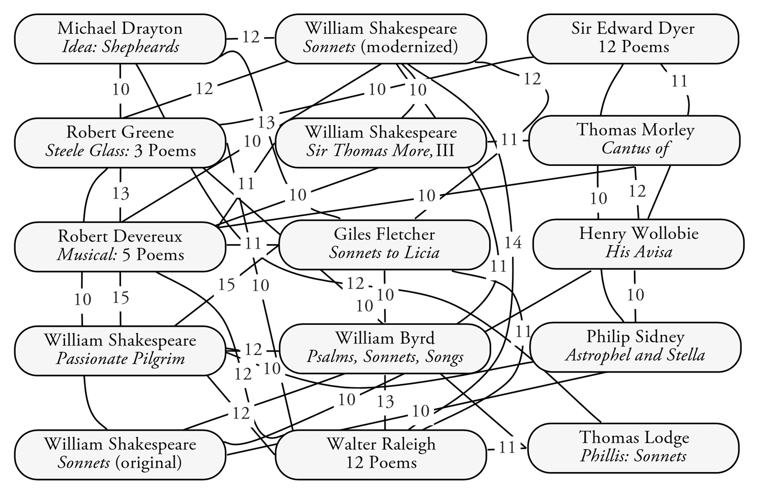
BYrd

Slide 5
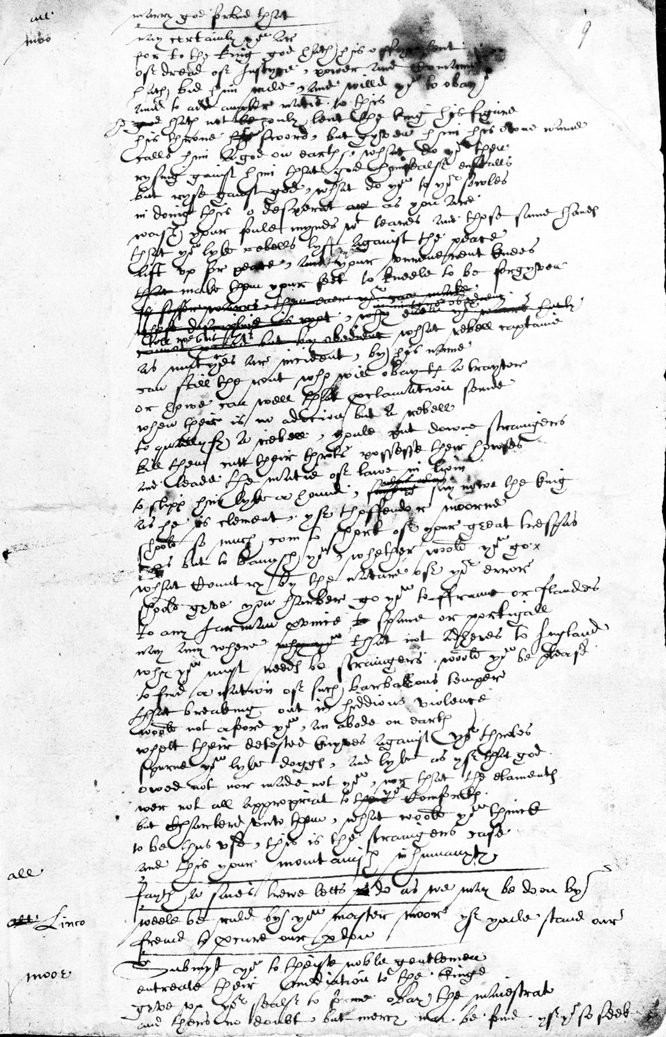
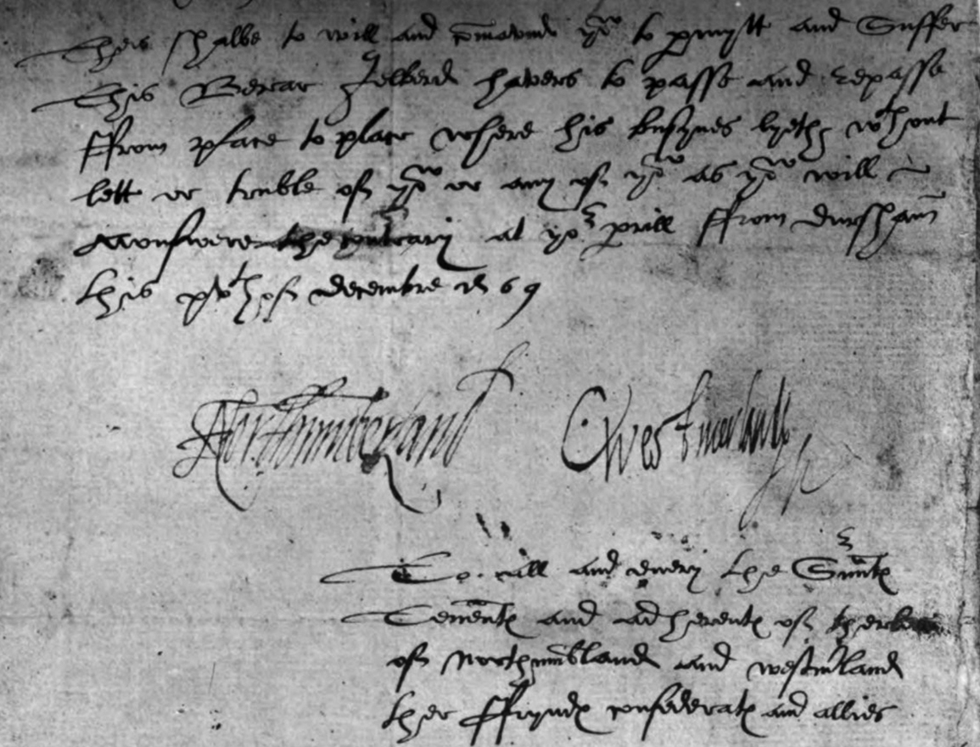
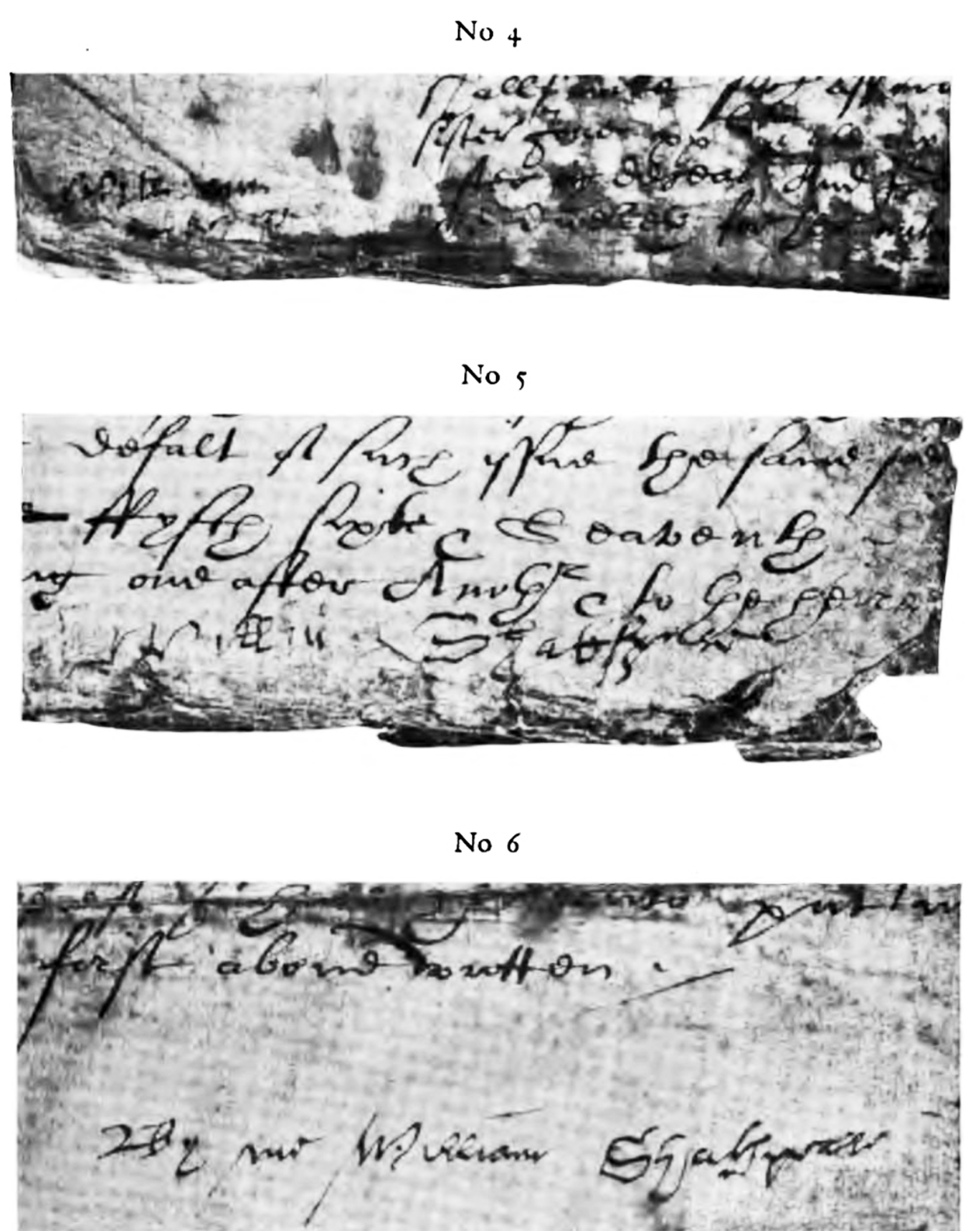
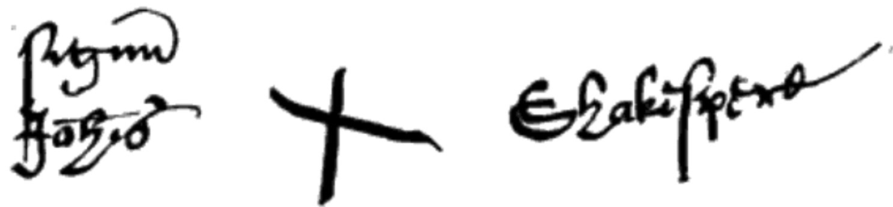
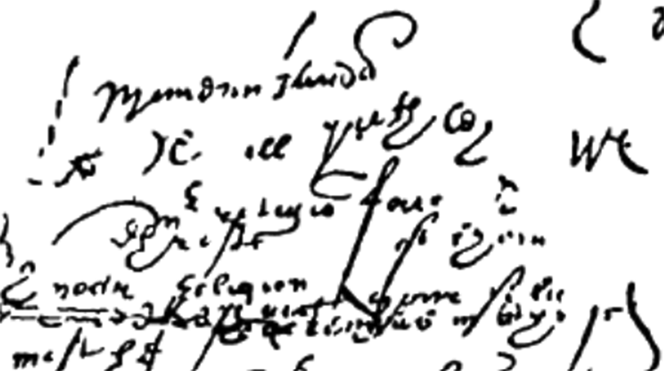
Percy: “Will Shakespeare” “Northumberland” “John Shakespeare” Northumberland MS Sir Thomas More

Slide 6
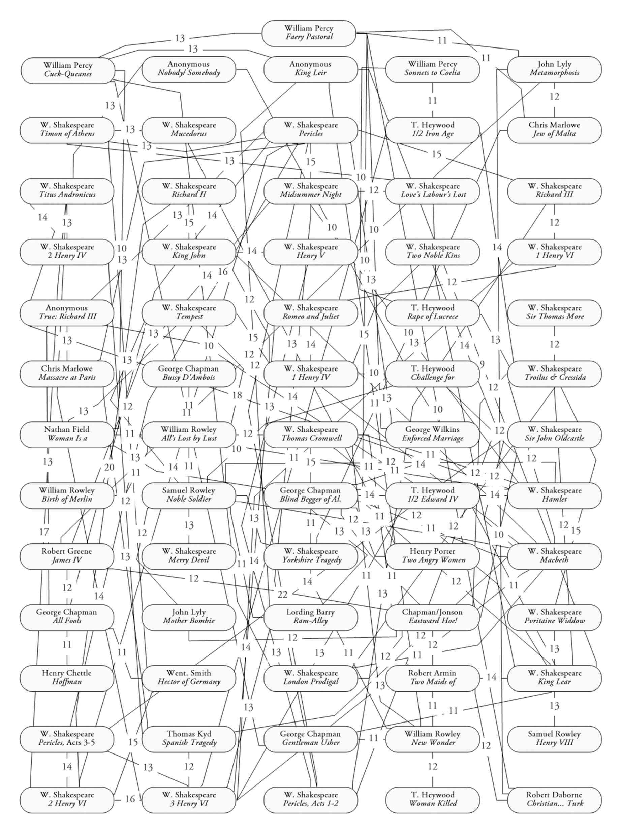
William Percy

Slide 7
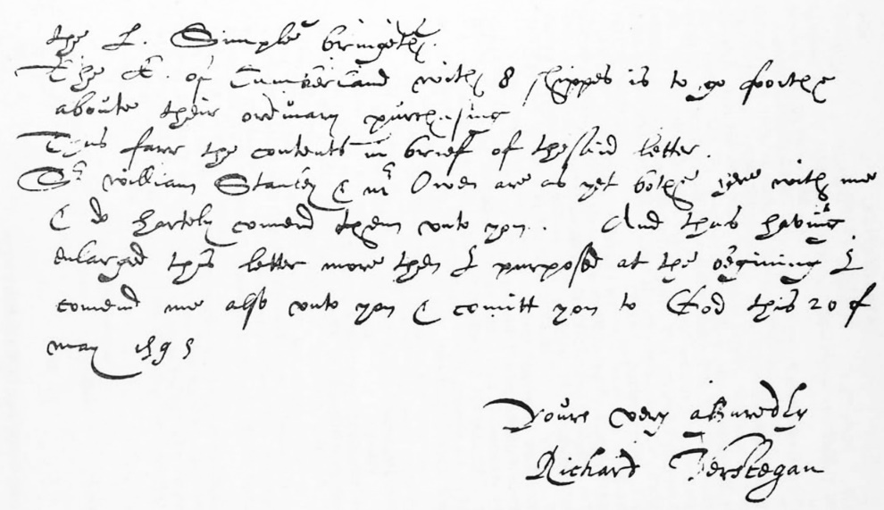
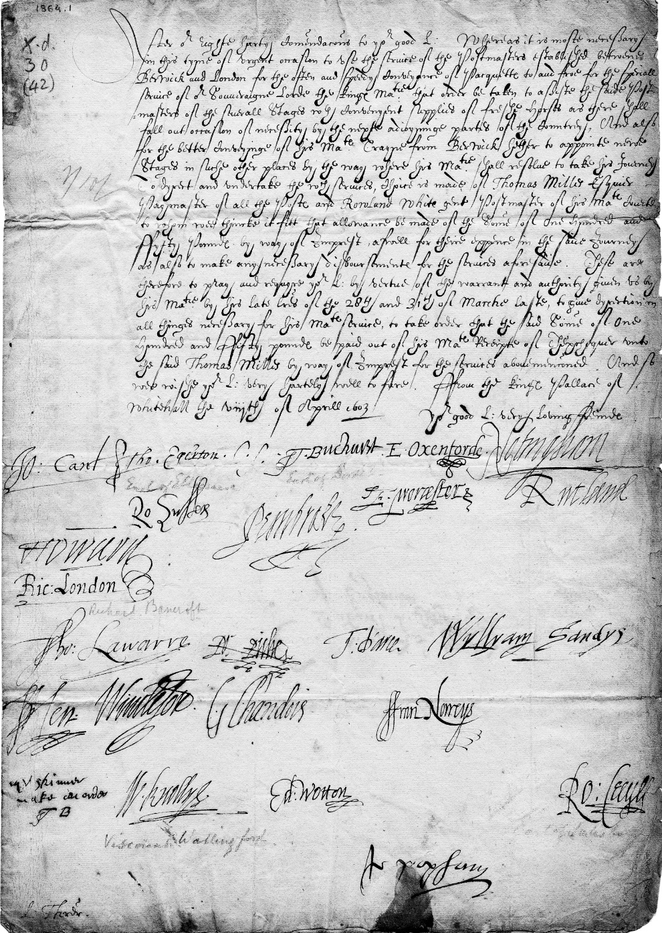
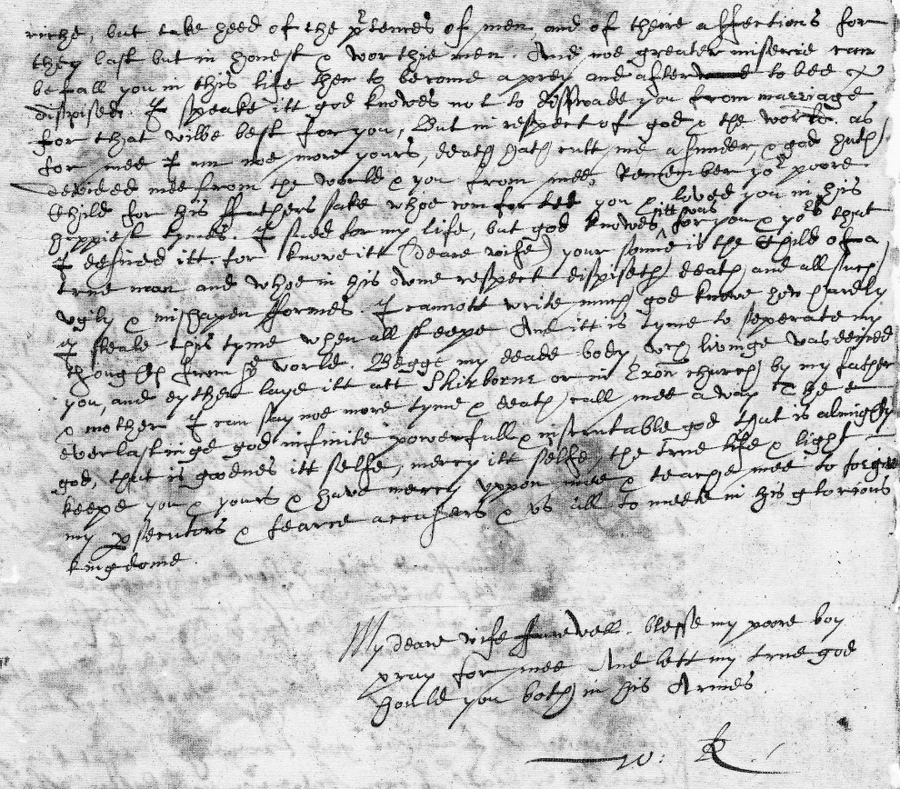
Richard Verstegan
vs
Walter
Raleigh
Vs
Privy
Council

Slide 8
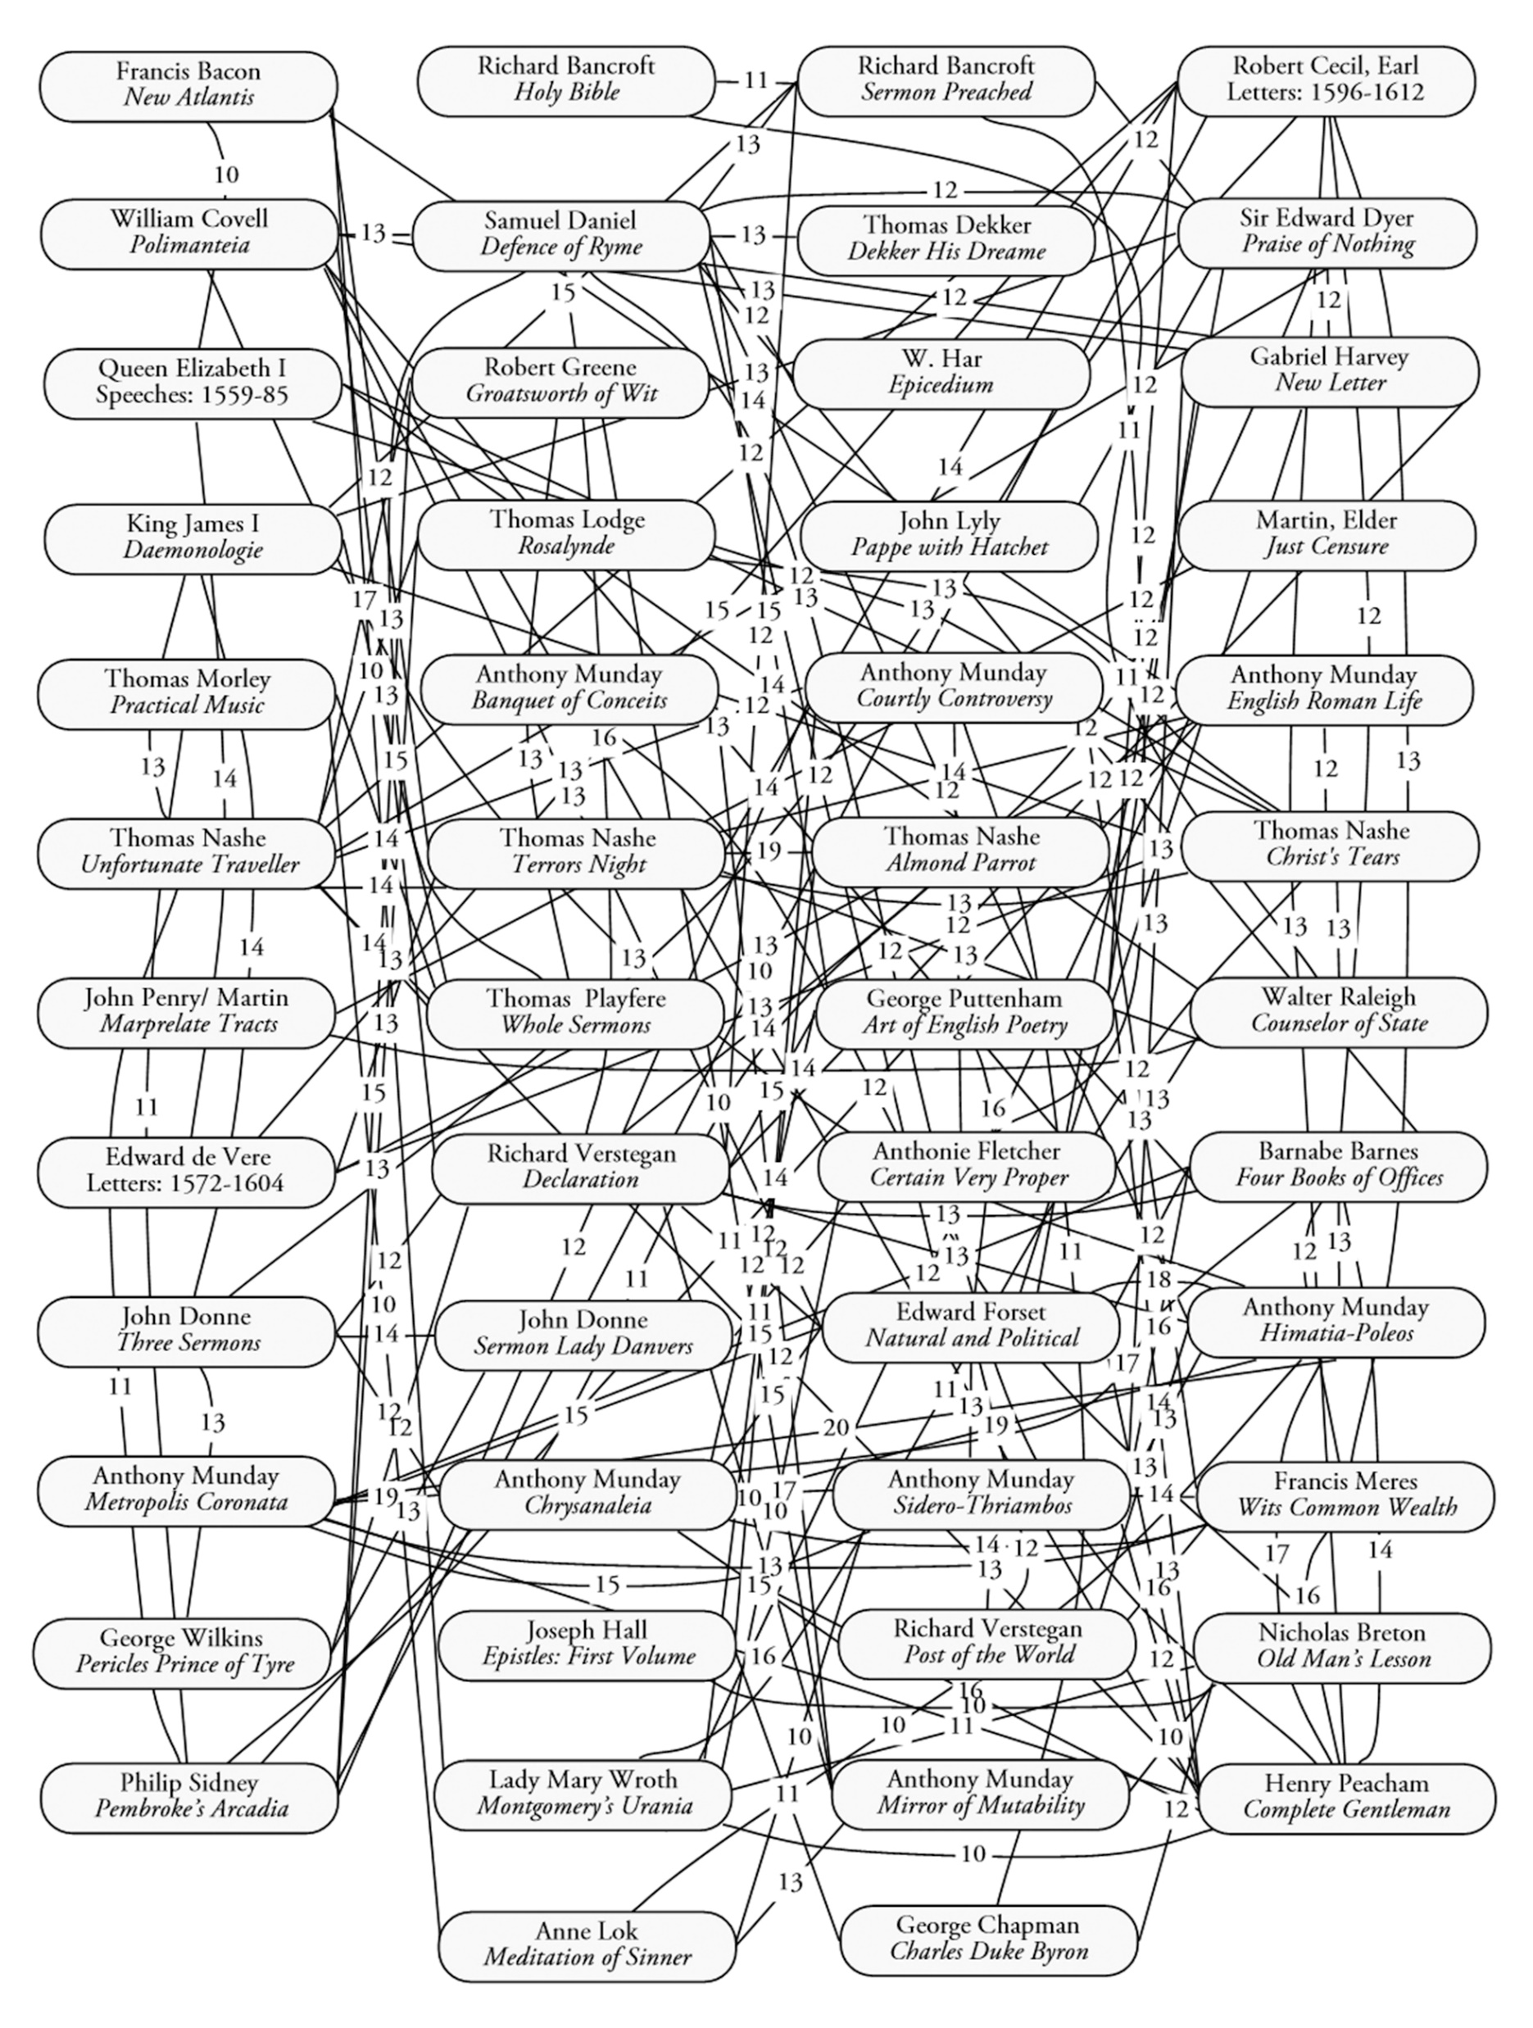
Richard Verstegan

Slide 9
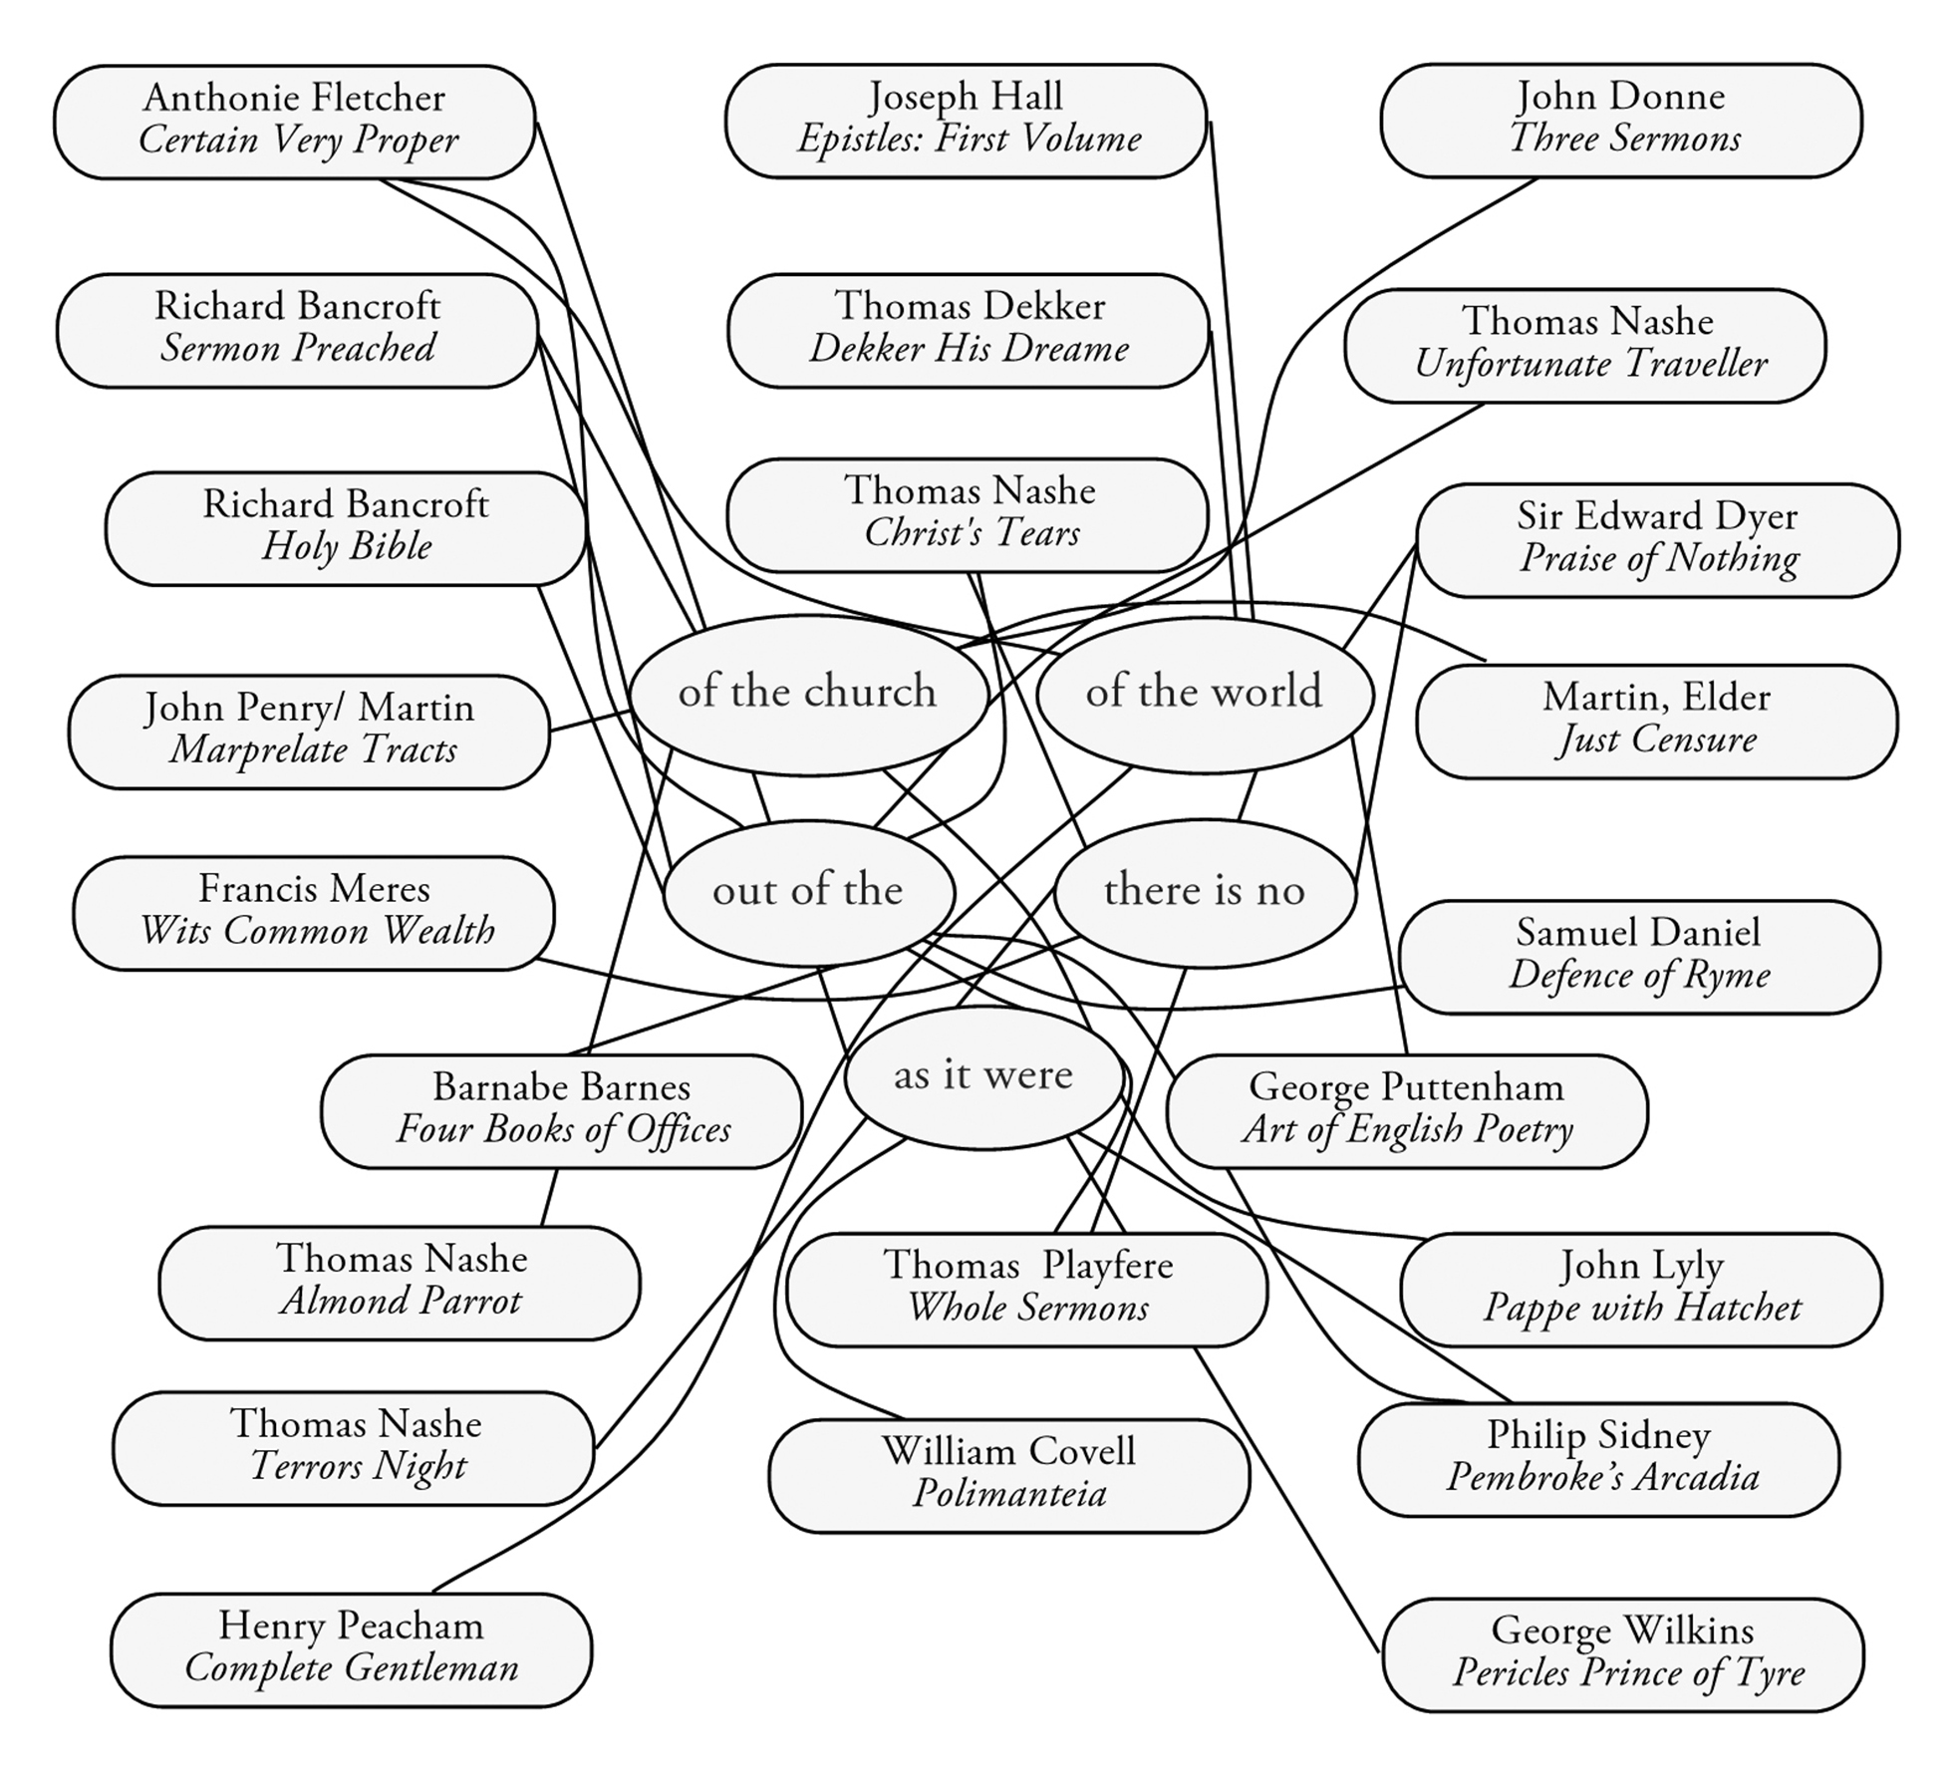
Richard Verstegan

Slide 10
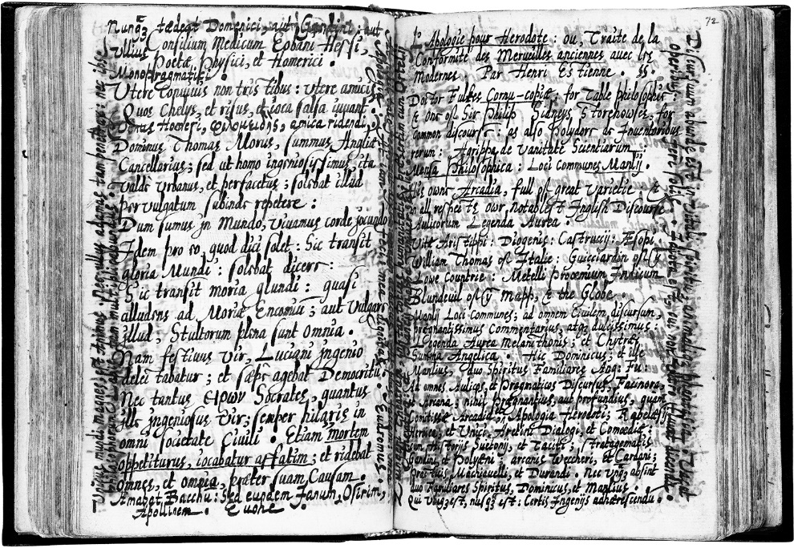
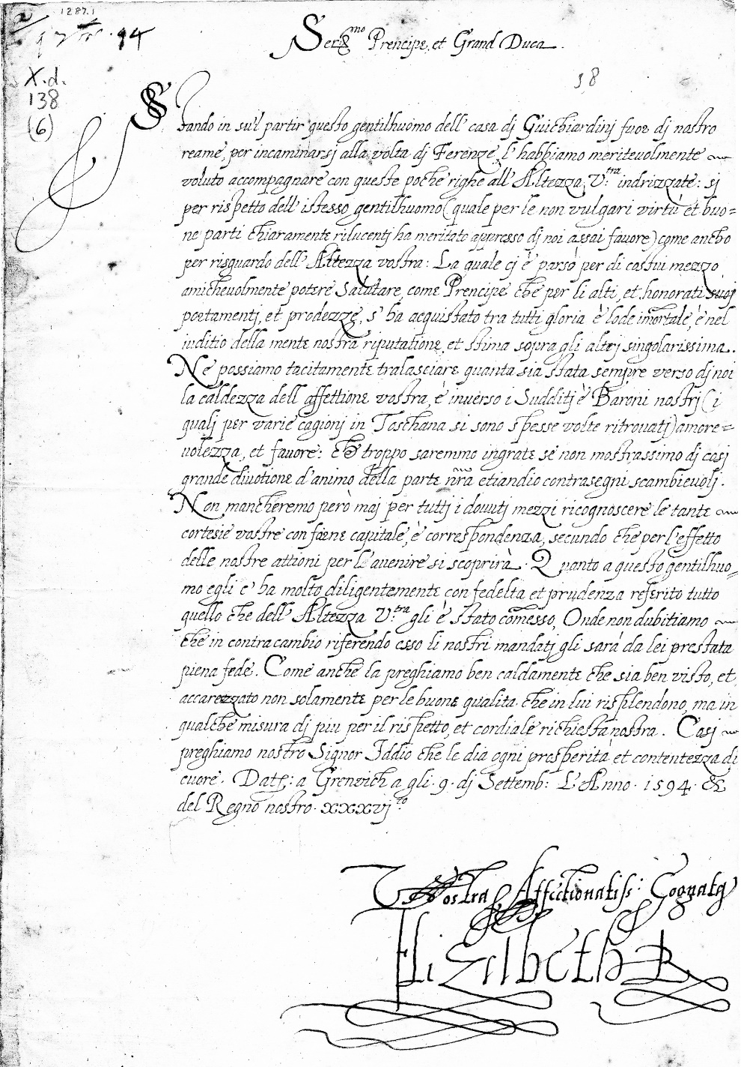
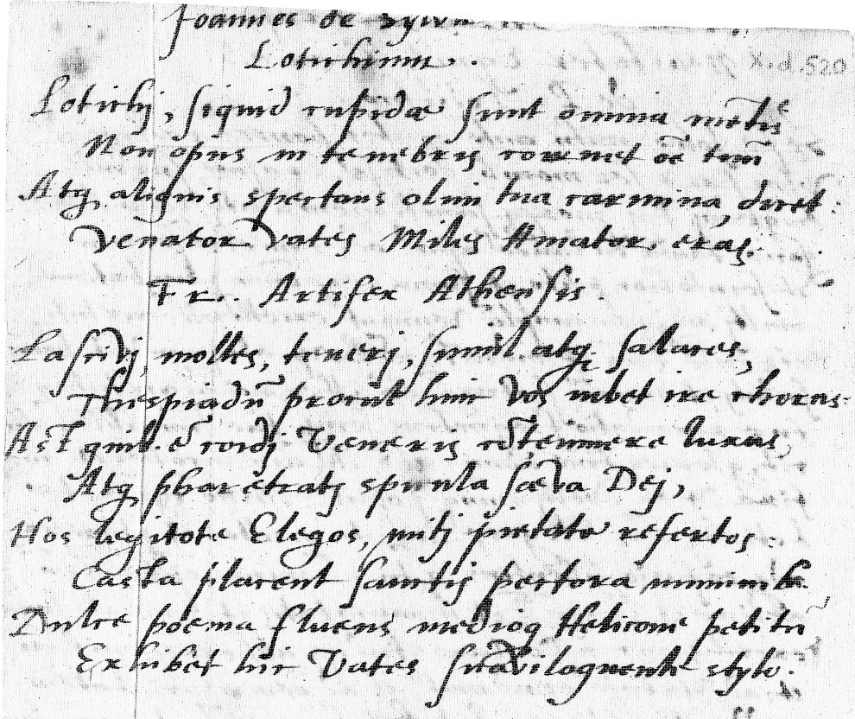
Gabriel Harvey
Vs.
Edmund
Spenser
Vs.
Queen
Elizabeth I

Slide 11
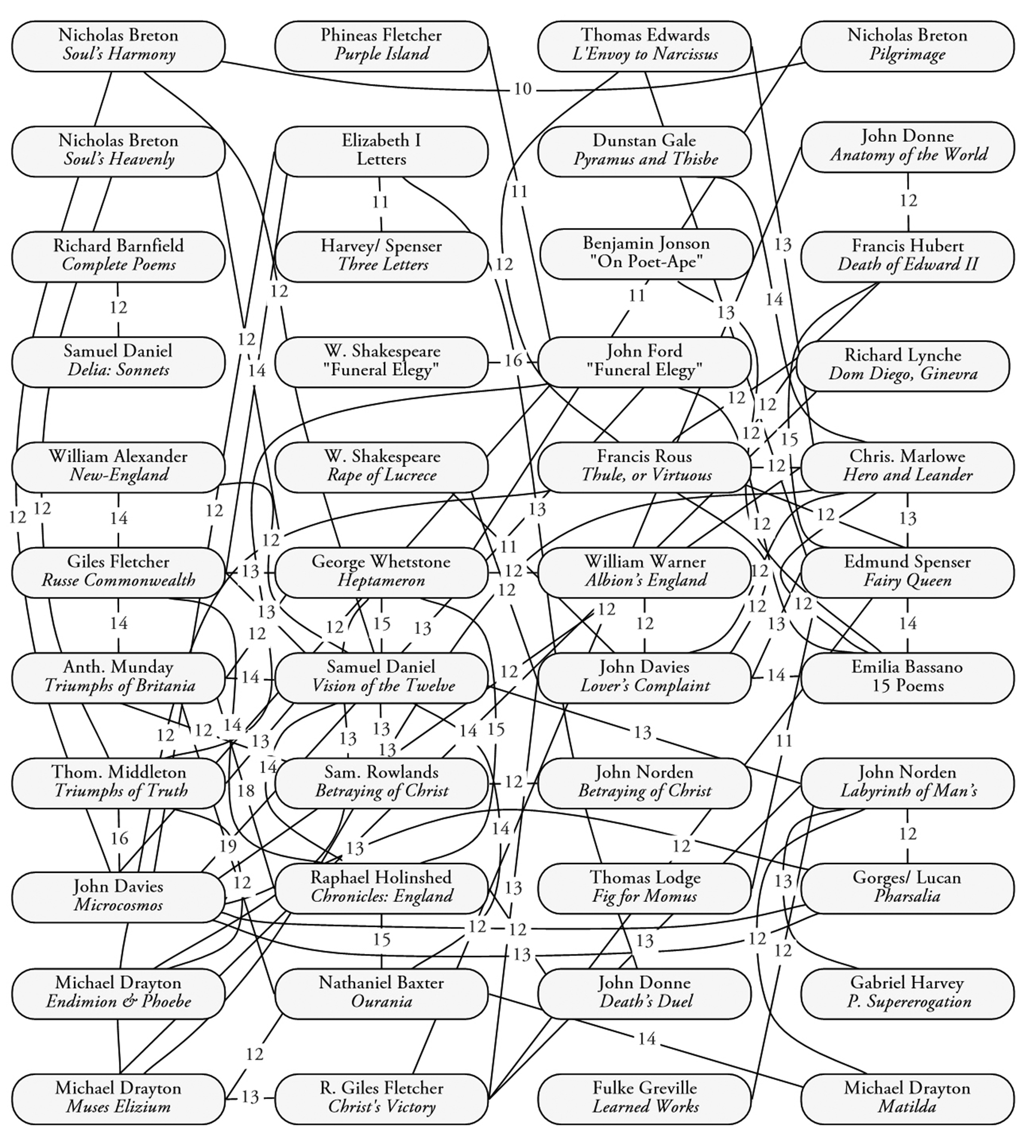
Gabriel Harvey

Slide 12
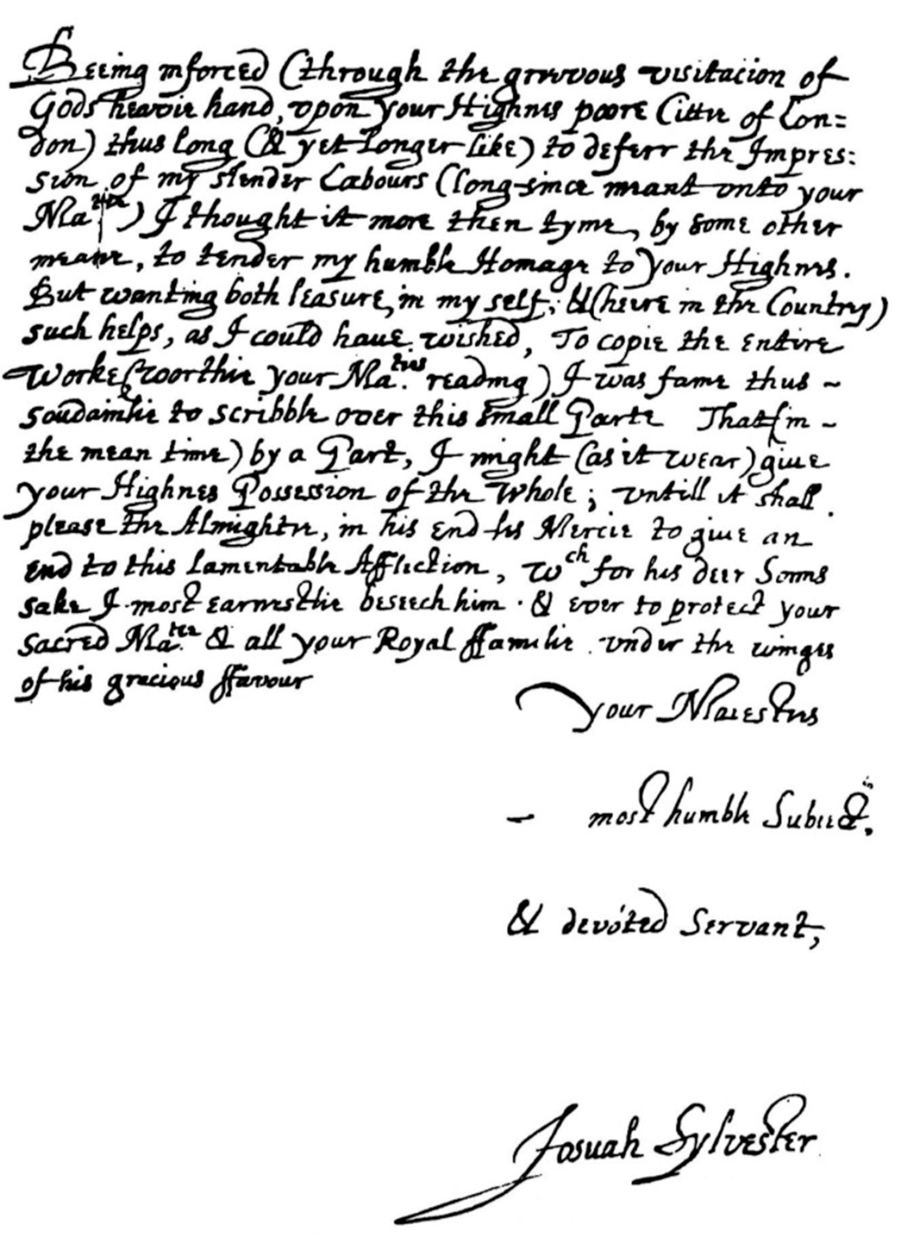
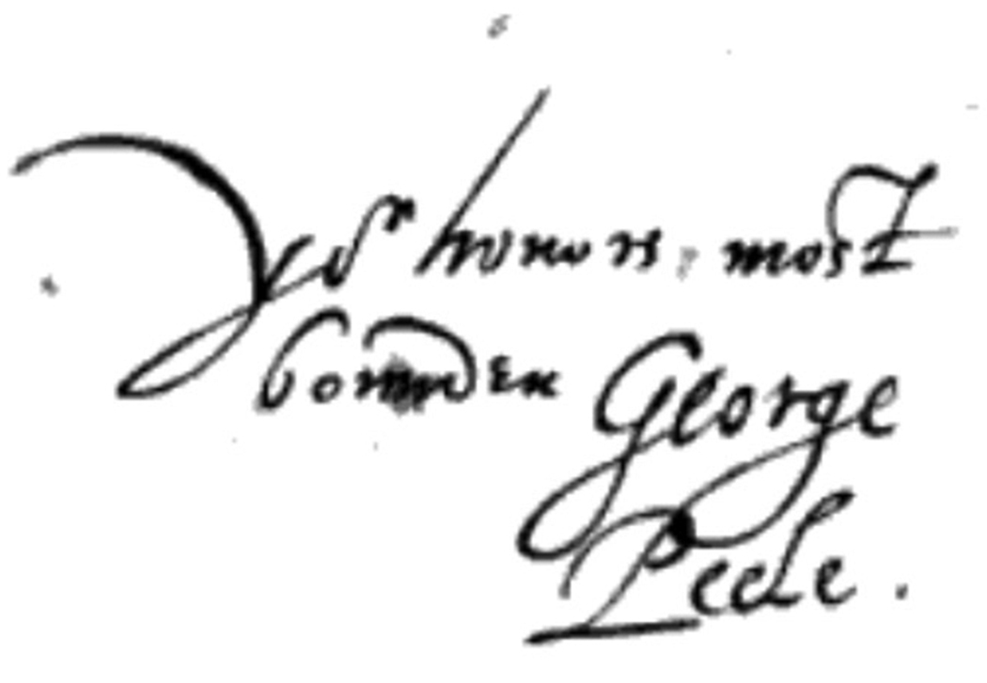
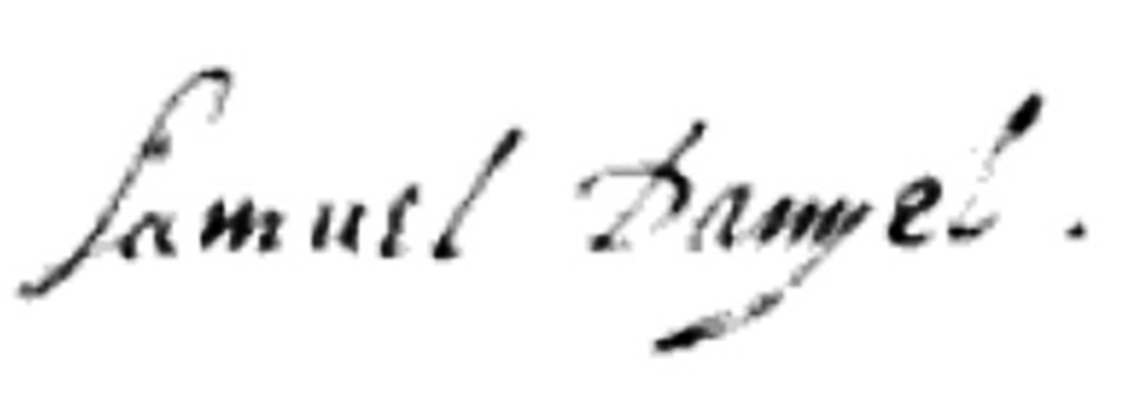
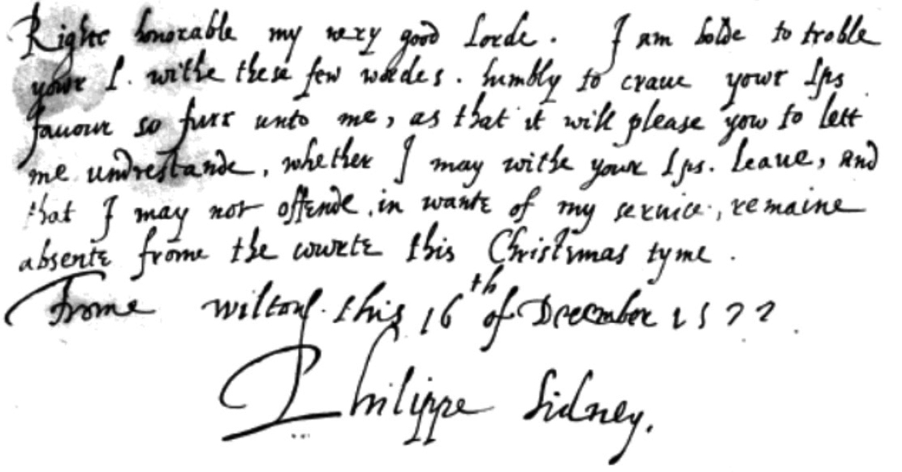
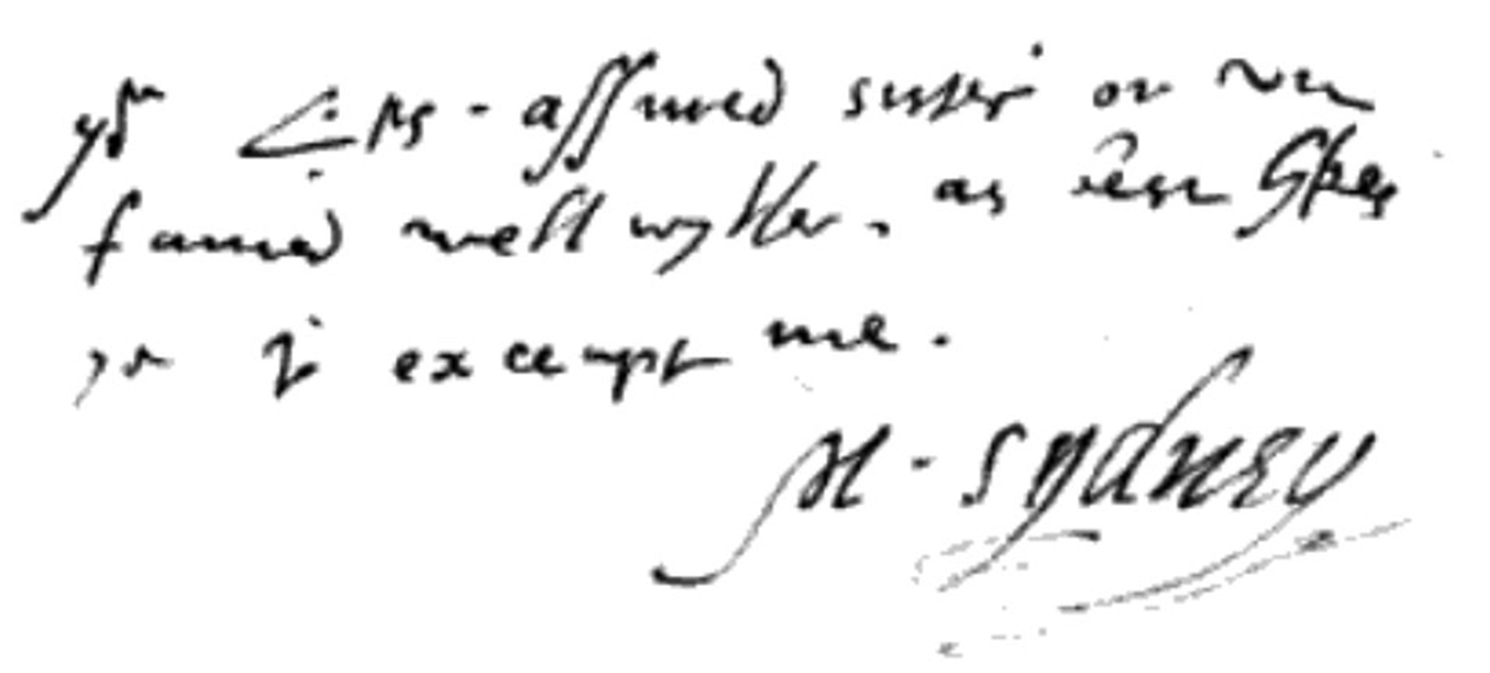
Josuah Sylvester George Peele Samuel Daniel Philip Sidney Mary Sidney

Slide 13
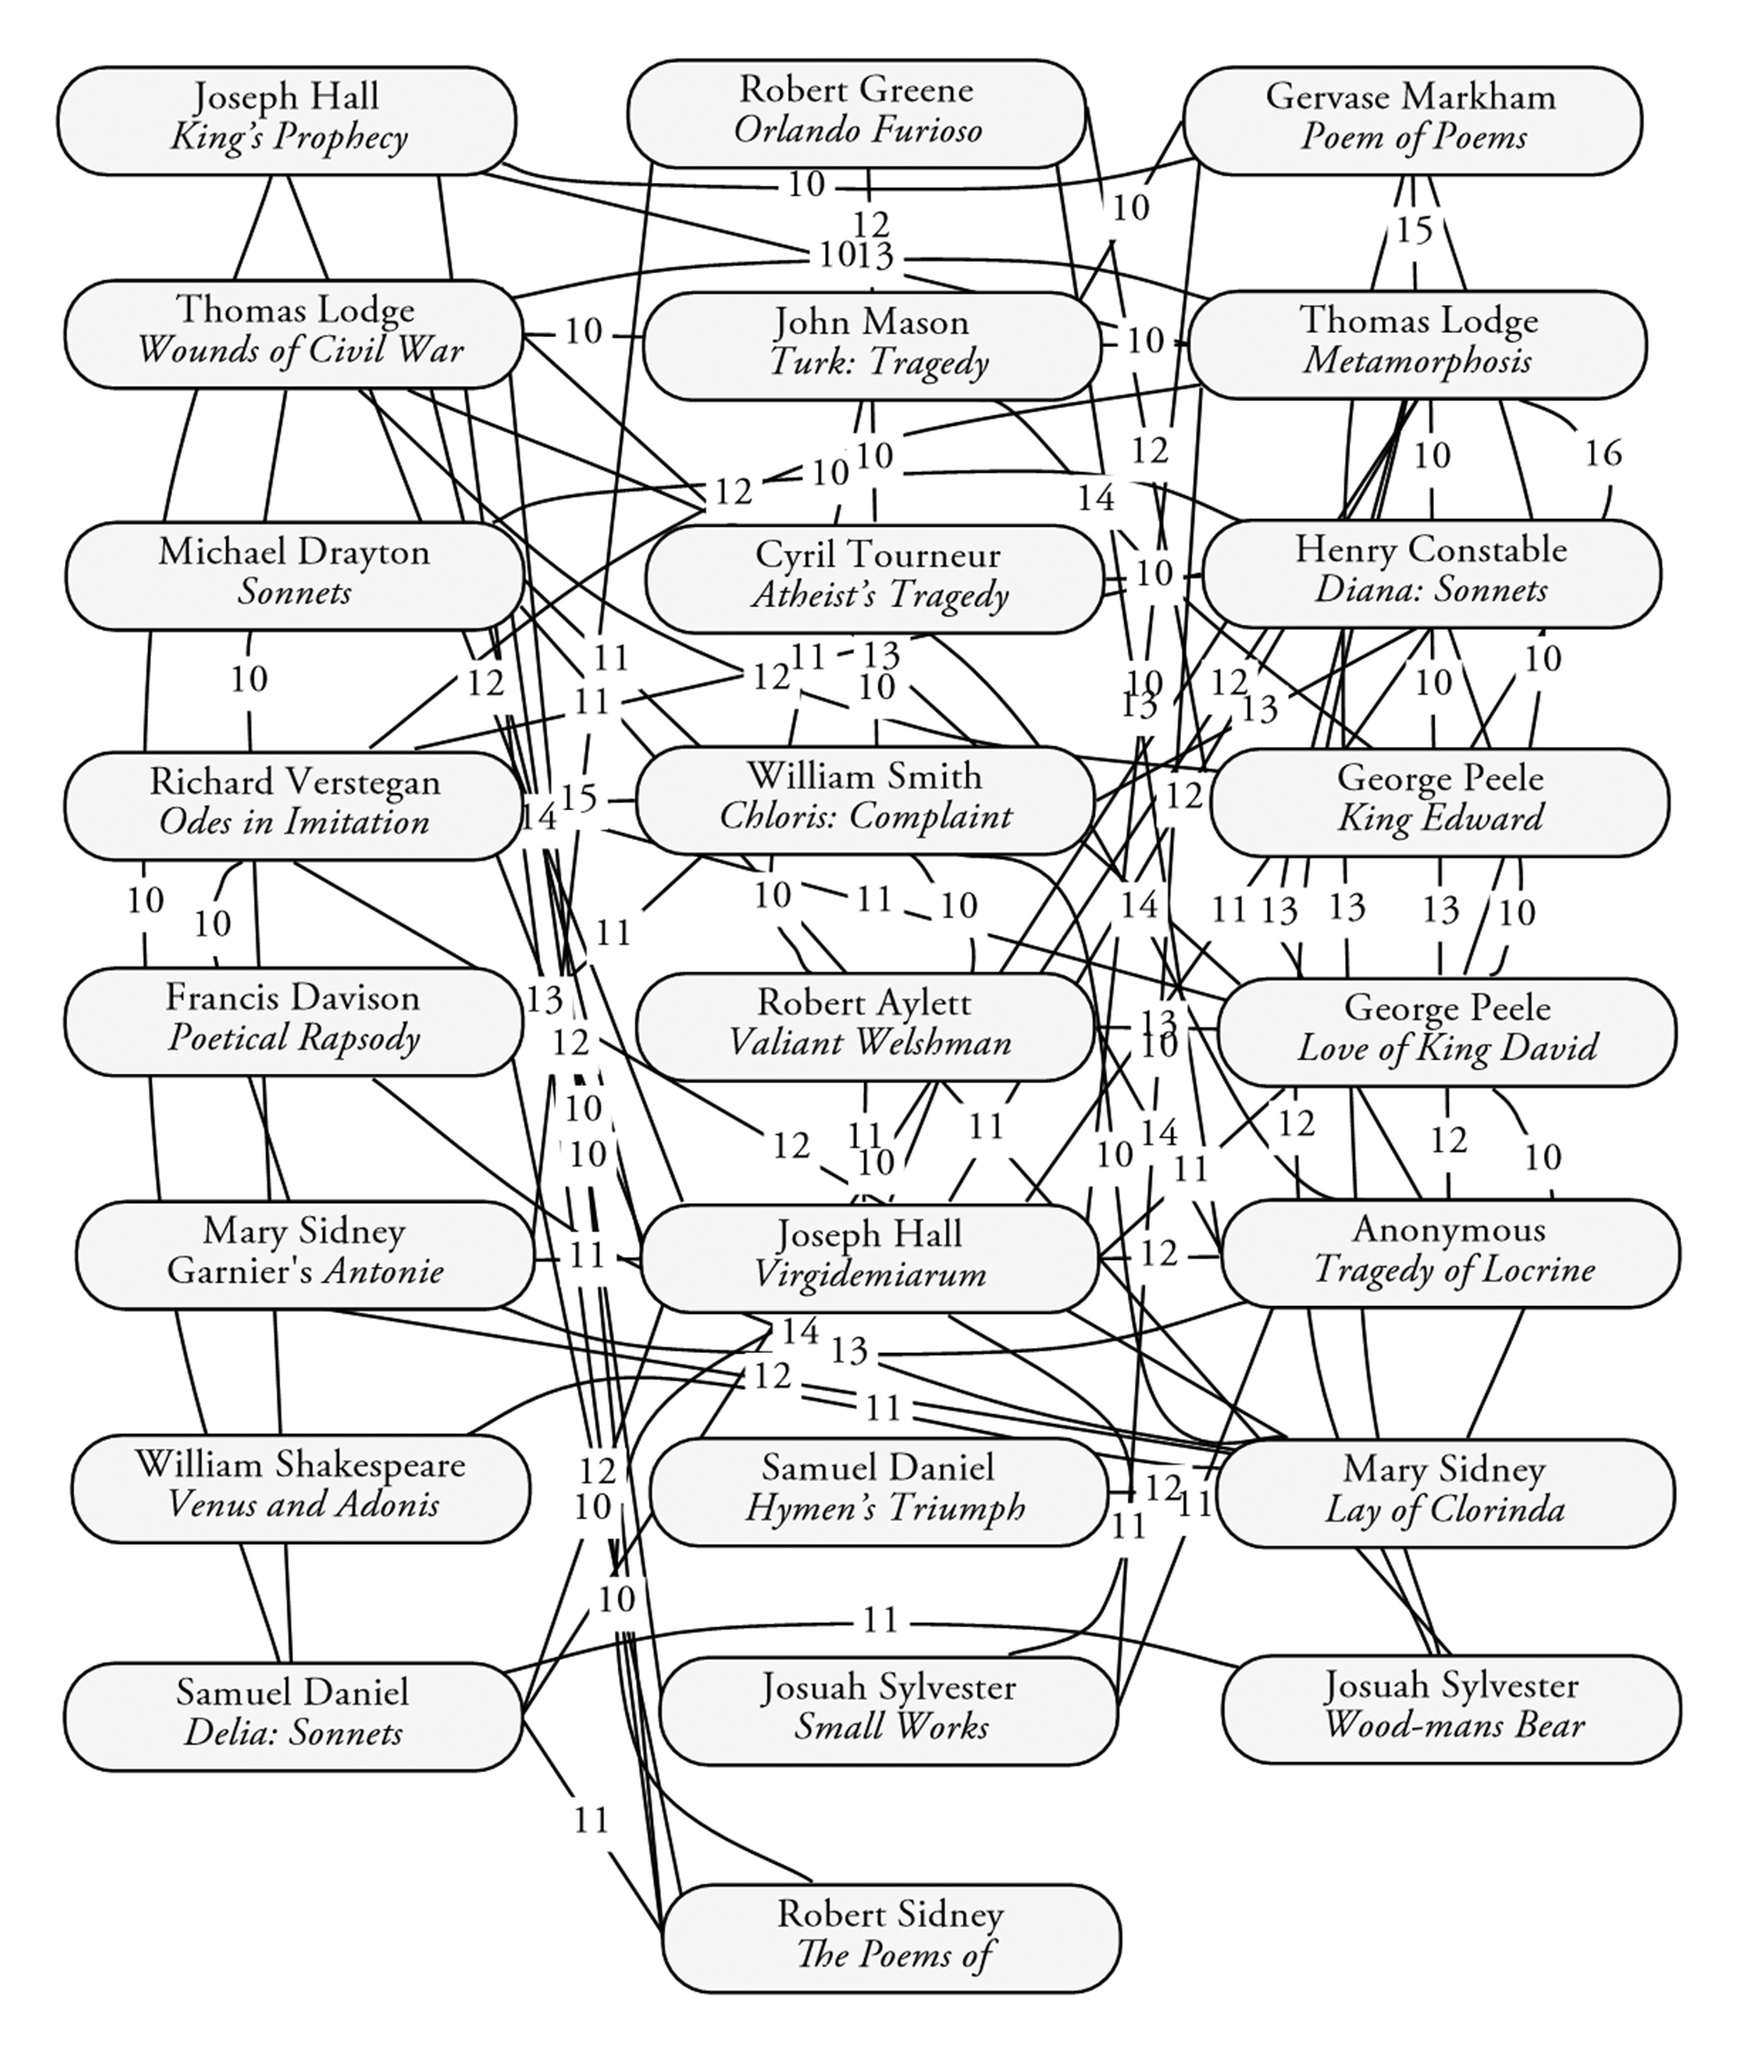
JoSuah Sylvester

Slide 14
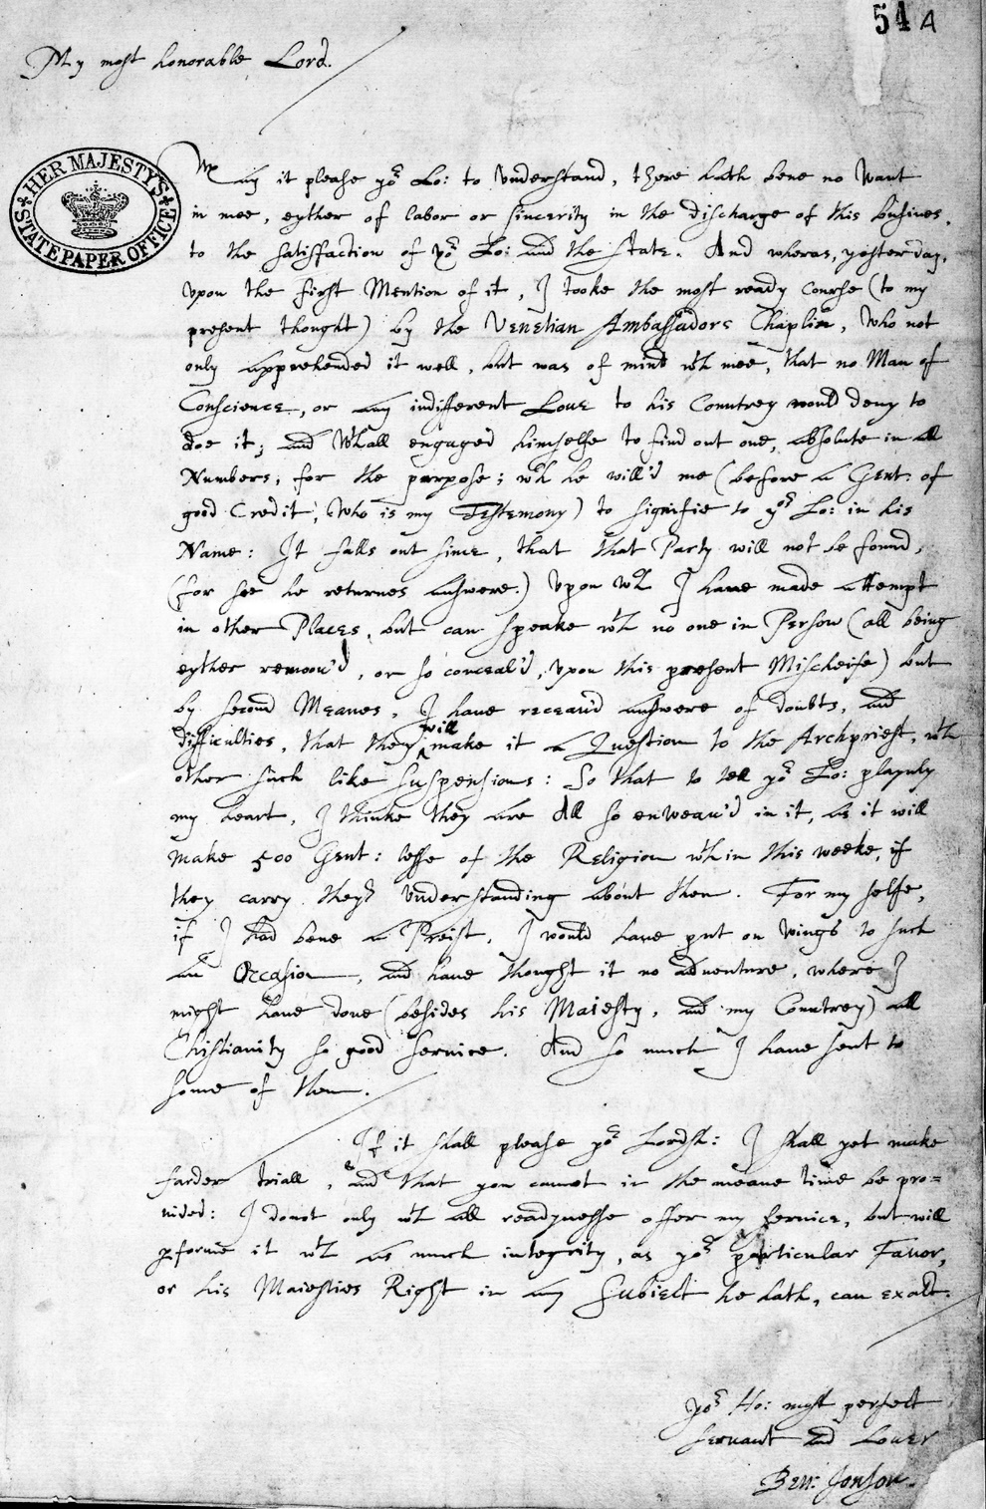
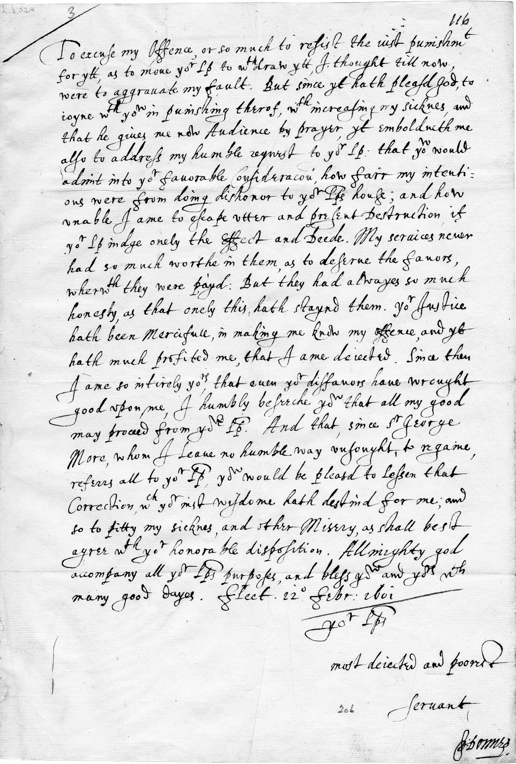
Ben Jonson
vs.
John
Donne

Slide 15
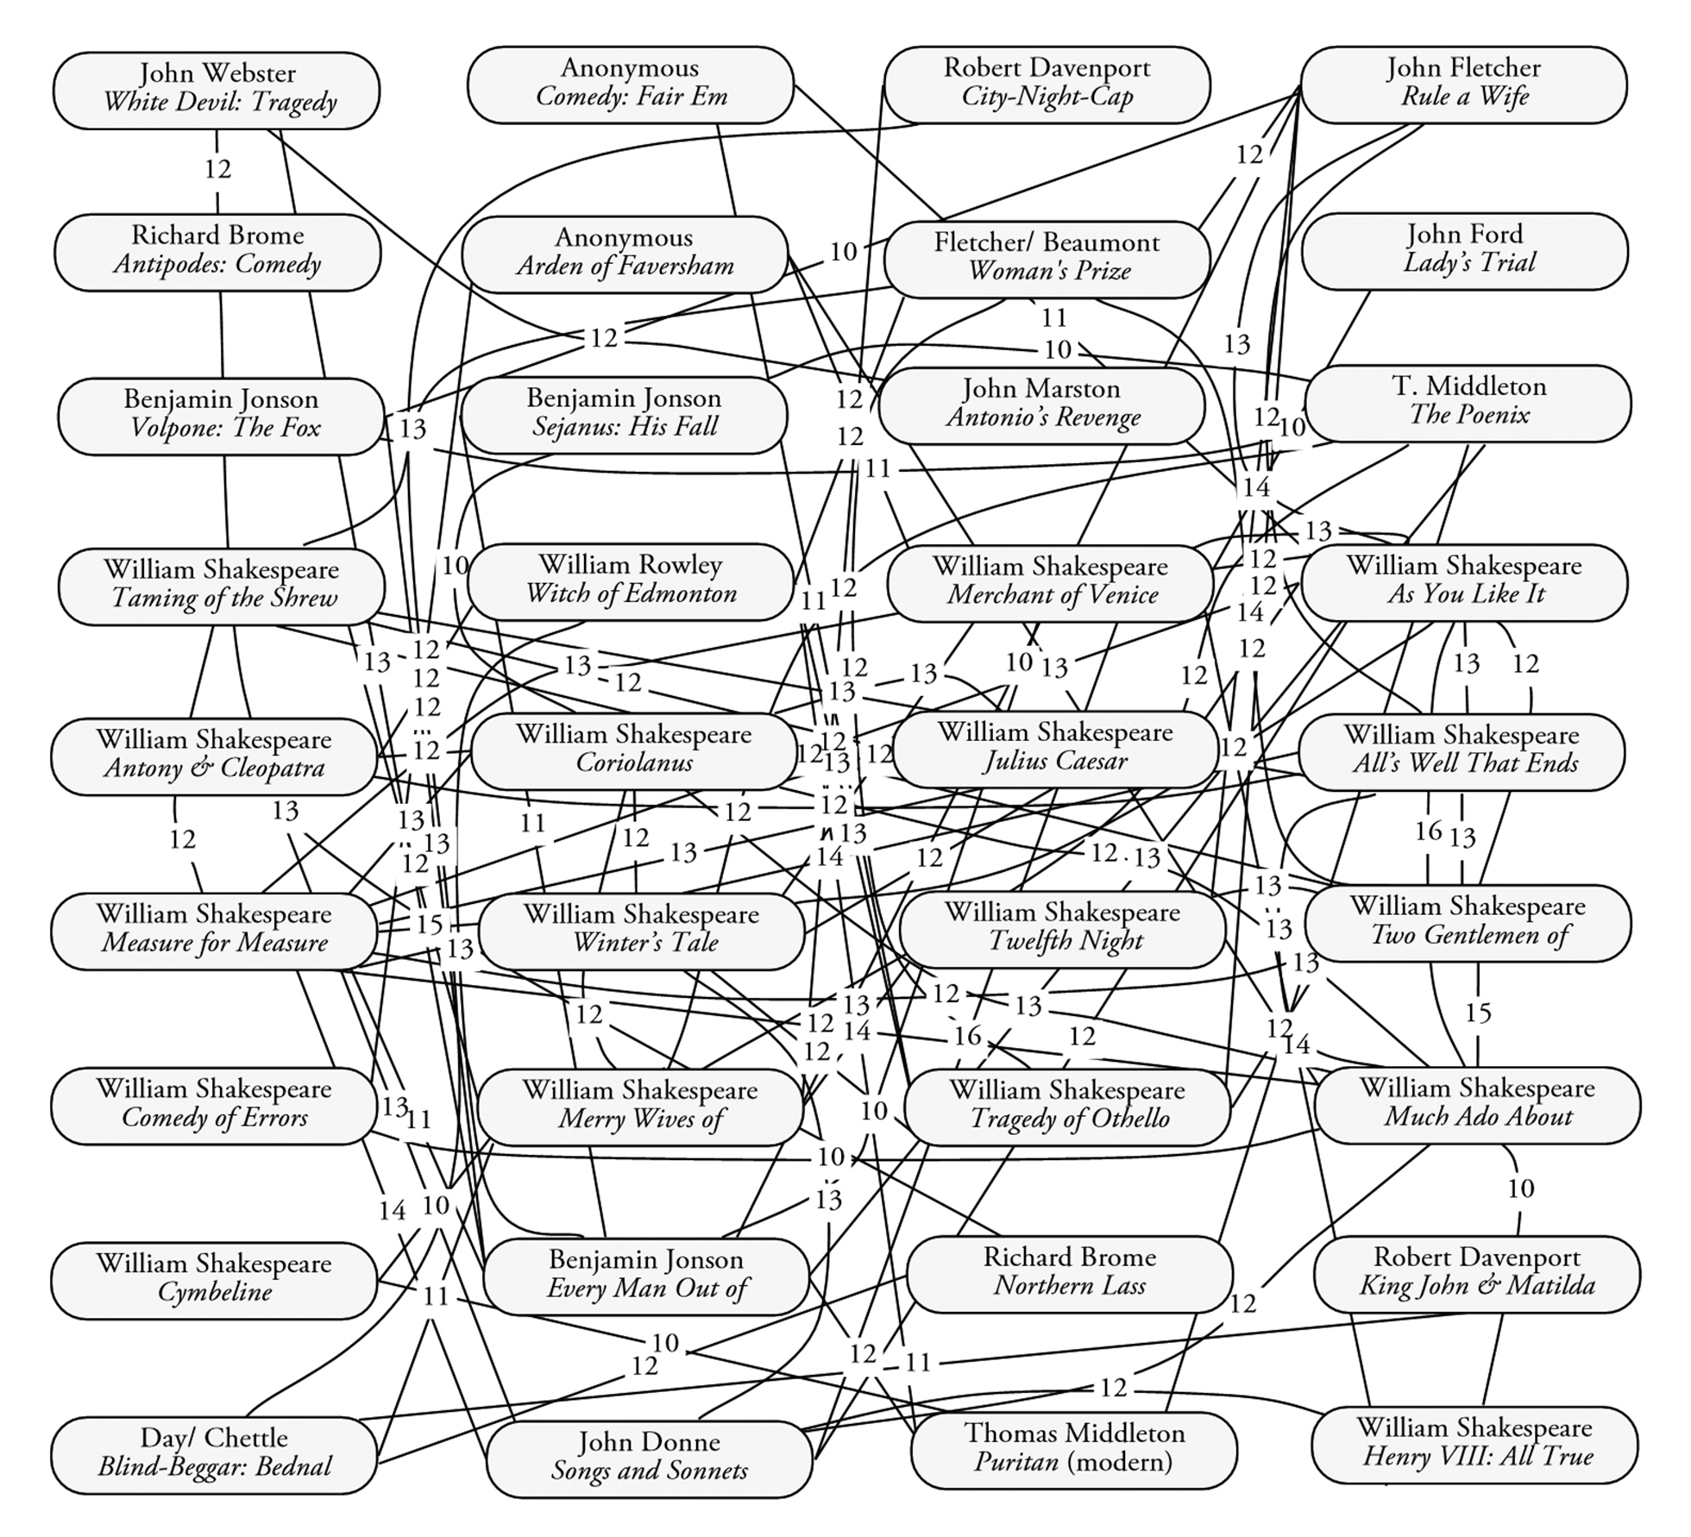
Ben JOnson

Slide 16
27-Tests Method: Steps
1. Find a group of texts from a given period that are connected to an authorial mystery you want to solve, and save them as plain documents (.doc/x and .txt).
2. Open free publicly-accessible websites—www.analyzemywriting.com, www.online-utility.org, or http://liwc.wpengine.com—and download the WordSmith program.
3. Enter each of the texts separately into each of these platforms and record the data for several linguistic tests into a spreadsheet. Renaissance corpus: 27 tests for: punctuation, lexical density, parts of speech, passive voice, characters and syllables per word, psychological word-choice, and patterns of the top-6 words and letters. The tests for top-6 words and letters require additional steps. Your first column should be the titles of all texts in the group, and the top row should be the names of the different tests applied to them. You will want to create duplicates of this raw data in separate tabs in the spreadsheet, with one sheet for each text in the group.
4. In the spreadsheet, organize the numbers for each of the tests from-smallest-to-largest, and mark only the texts that are with 17-18% of the compared text on this spectrum. For example, if you are only testing 20 texts, you can select 2 texts just above and 2 more just below your compared-against text’s value and change their numbers to 1, while changing all of the other numbers to 0; the 1 means the texts are similar, while the 0 means they are different.
5. When you have changed the entire sheet’s data into 0s and 1s, create a last column and automatically add up the Sum for each row.
6. Evaluate your results to determine what number in the sum column means two texts are by the same author, or if they were written by two or more authors, or if they were written by different authors. You will have to create a cut-off point for the number of matches that separate similar from divergent texts in your chosen set of texts. Find out more: https://anaphoraliterary.com/attribution/

Slide 17
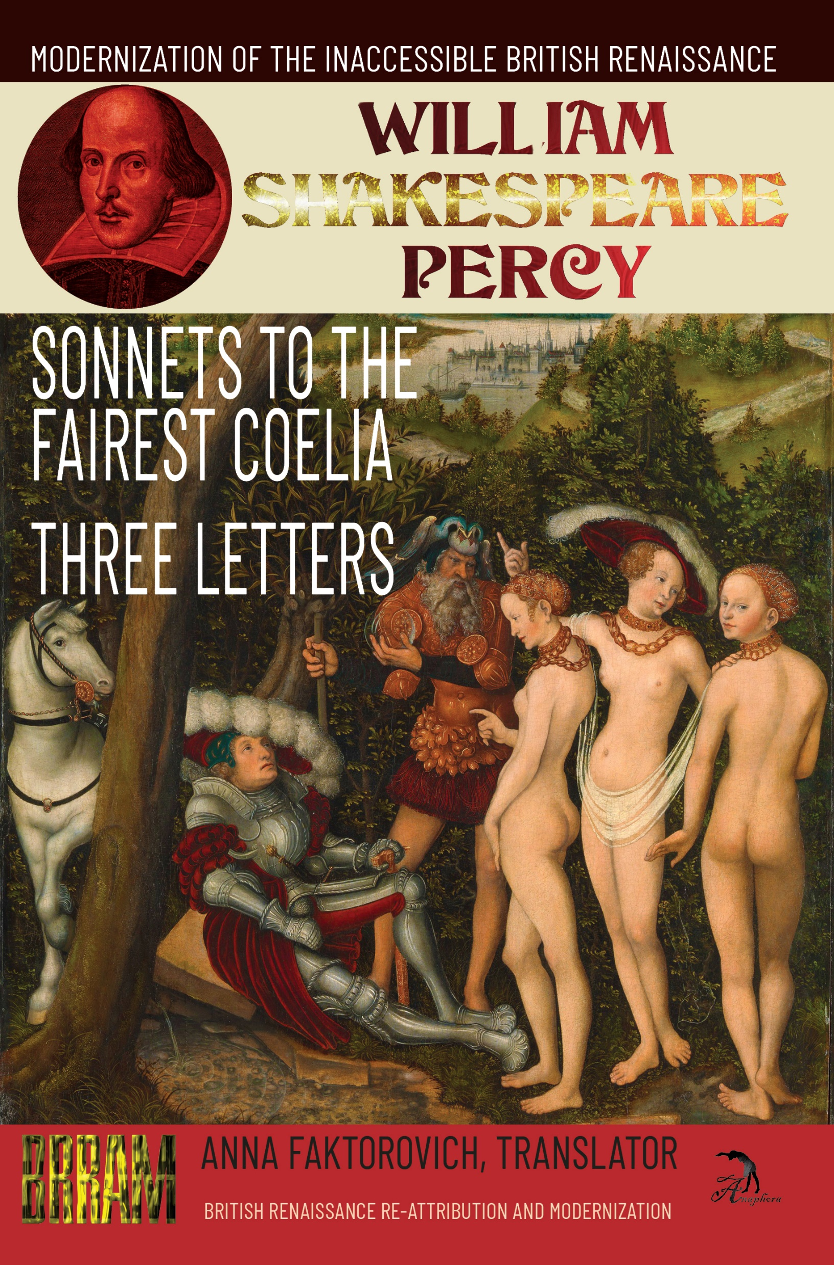
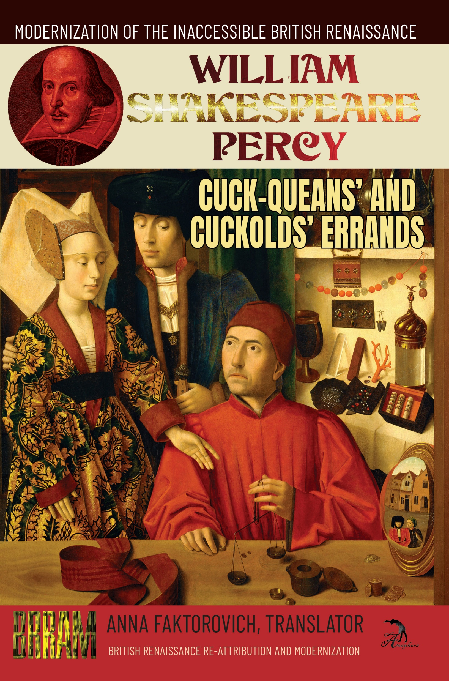

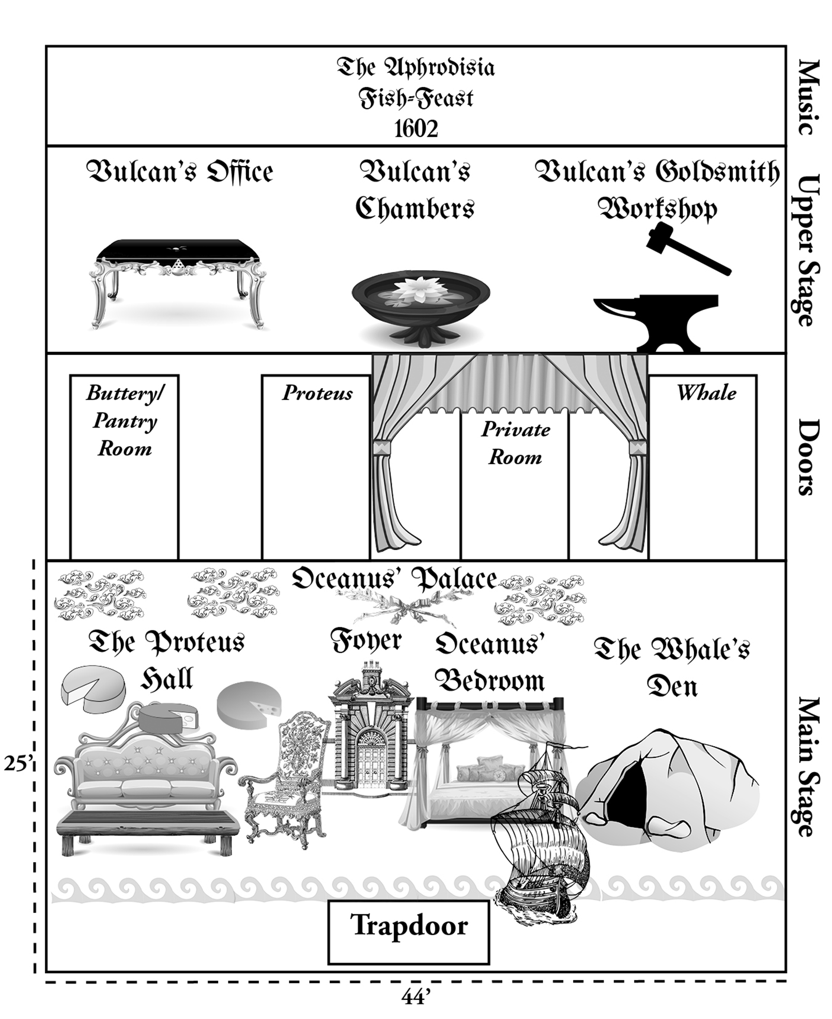
British Renaissance Re-Attribution and Modernization Series
Raw and Computed Data, Graphs, Handwriting Clusters:
https://github.com/faktorovich/Attribution

